Slide 1
First Letter of your last name:____________________
Your Full Name: _______________________________
COM S 363: Exam Final
Time: 5 hours
NOTES:
This is an open book open note exam.
You must work by yourself, without discussing with anyone else except TAs or instructors.
You can handwrite, but you are strongly encouraged to type/draw on these slides directly. Some shapes may be given for your convenience. If you do handwrite, write legibly; if the grader can't read, at their sole discretion, you receive no point.
Answer concisely and precisely. One effective way to lose points is to write nonsenses. HINT: The spaces you are given are more than you need.
Submit your file in PDF format.
Problem | Max Points | Points
1 | 15
2 | 20
3 | 18
4 | 6
5 | 9
6 | 10
7 | 15
8 | 7
Total | 100

Slide 2
1. (15 points) Consider an ONLINE AUCTION database system in which members (buyers and sellers) participate in the sale of items. The data requirements for this system are summarized as follows:
The online site has members, each of whom is identified by a unique member number and is described by an e-mail address, name, password, home address, and phone number.
A member may be a buyer or a seller, or both, or not at all. A buyer has a shipping address recorded in the database. A seller has a bank account number and routing number recorded in the database.
Every item must have one and only one seller. They are placed by a seller for sale and are identified by a unique item number assigned by the system. Items are also described by an item title, a description, starting bid price, bidding increment, the start date of the auction, and the end date of the auction.
Buyers make bids for items they are interested in. Bid price and time of bid is recorded.
A bidder at the end of the auction may be declared the winner of an item. An item can have only one winner.
When a winner is declared, the buyer and seller may record feedback regarding their experience on the sale process. Feedback contains a rating of the other party participating in the transaction (1-10) and a comment.
Draw an ER diagram that captures all attributes of each entity set and each relationship set for the above requirements. Specify the key for each entity set and all the constraints for each relationship set. Specify any necessary overlap and covering constraints (in English). Use the ER notations introduced in our lectures.
Please draw your diagram in the next slide. The notations below are provided for your convenience. They are not meant to be complete, nor will you need all of them.
m
u
isa

Slide 3
Draw your ER diagram on this slide
email
name
password
ID
address
member
phoneNumber
ShippingAddr
isa
AccountNum
No constraint
RoutingNum
buyer
seller
m
m
m
Seller_rating
time
buyer_rating
bid
place_for_bid
win
Seller_feedback
price
m
buyer_feedback
u
u
item
bid_increment
Staring_bid_price
ID
title
description
4 Entities: 8 points (1 point for each set and 1 point for attributes)
1 ISA: 1 point
3 Relationships: 6 points
0.5 point for each set and 0.5 for attributes
0.5 for each line and u/m

Slide 4
2. (20 points) We have the following relations.
Students
Departments
Degrees
Majors
Minors
Courses
snum | name | gender
1001 | Randy | M
1005 | Nicole | F
code | name | college
401 | Computer Science | LAS
402 | Mathematics | LAS
403 | Chemical Engineering | Engineering
404 | Landscape Architect | Design
name | level | department_code
Computer Science | BS | 401
Software Engineering | BS | 401
Computer Science | MS | 401
Computer Science | PhD | 401
Applied Mathematics | MS | 402
Chemical Engineering | BS | 403
Landscape Architect | BS | 404
snum | name | level
1001 | Computer Science | BS
1005 | Applied Mathematics | MS
snum | name | level
1005 | Computer Science | MS
1001 | Software Engineering | BS
number | name | description | credithours | level | department_code
113 | Spreadsheet | Microsoft Excel and Access | 3 | Undergraduate | 401
311 | Algorithm | Design and Analysis | 3 | Undergraduate | 401
531 | Theory of Computation | Theorem and Probability | 3 | Graduate | 401
363 | Database | Design Principle | 3 | Undergraduate | 401
412 | Water Management | Water Management | 3 | Undergraduate | 404
228 | Special Topics | Interesting Topics about CE | 3 | Undergraduate | 403
114 | Calculus | Limit and Dirivative | 4 | Undergraduate | 402
Continue to next page ….

Slide 5

(continue from the previous page)
Registers
snum | course_number | regtime | grade
1001 | 363 | Fall2015 | 3
1005 | 412 | Spring2015 | 4
a). (10 points) Please show the results for the following relational algebra expressions
Answer with minor problem: 1. Minor problem include: $±1$ row, $±1$a column, wrong field name. Major problem (work on wrong tables, totally wrong answers, clearly didn’t understand the expression)
For all answers, order does not matter
1). $π_{departmentcode}\left(courses\right)$ 2 points
2). $σ_{level=\text{MS}}\left(degrees\right)$ 2 points
3). $students×majors$ 3 points
4). $majors⋈degrees$ 3 points
department_code
401
404
403
402
name | level | department_code
Computer Science | MS | 401
Applied Mathematics | MS | 402
students.snum | students.name | gender | majors.snum | majors.name | level
1001 | Randy | M | 1001 | Computer Science | BS
1001 | Randy | M | 1005 | Applied Mathematics | MS
1005 | Nicole | F | 1001 | Computer Science | BS
1005 | Nicole | F | 1005 | Applied Mathematics | MS
snum | name | level | department_code
1001 | Computer Science | BS | 401
1005 | Applied Mathematics | MS | 402
Continue to next page ….

Slide 6
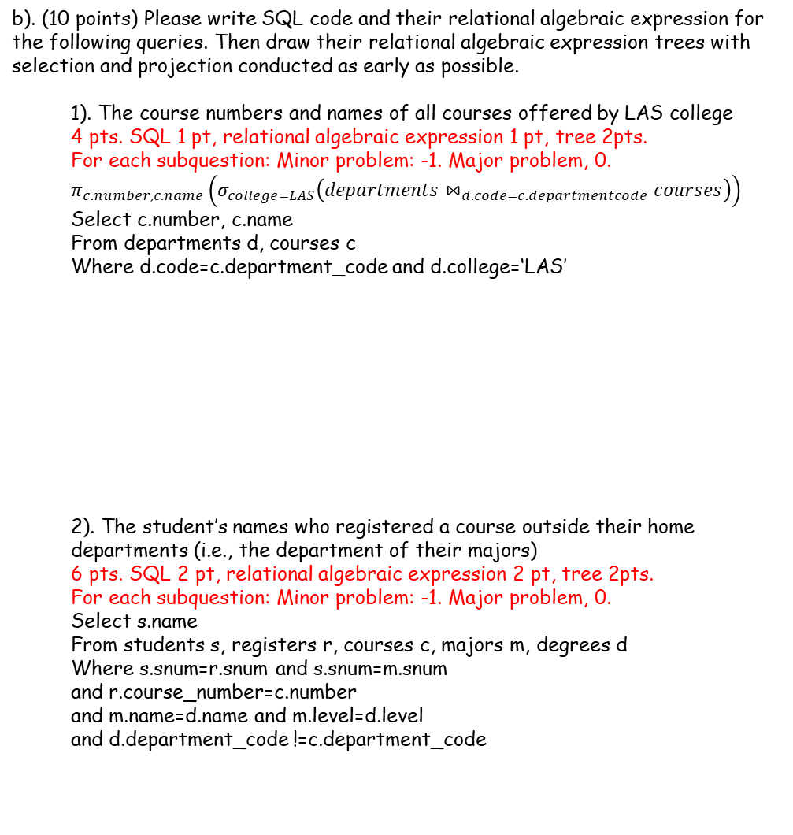
(continue from the previous page)
b). (10 points) Please write SQL code and their relational algebraic expression for the following queries. Then draw their relational algebraic expression trees with selection and projection conducted as early as possible.
1). The course numbers and names of all courses offered by LAS college 4 pts. SQL 1 pt, relational algebraic expression 1 pt, tree 2pts.
For each subquestion: Minor problem: -1. Major problem, 0.
$$π_{c.number, c.name}\left(σ_{college=LAS}\left(departments⋈_{d.code=c.departmentcode}courses\right)\right)$$
Select c.number, c.name
From departments d, courses c
Where d.code=c.department_code and d.college=‘LAS’
2). The student’s names who registered a course outside their home departments (i.e., the department of their majors)
6 pts. SQL 2 pt, relational algebraic expression 2 pt, tree 2pts.
For each subquestion: Minor problem: -1. Major problem, 0.
Select s.name
From students s, registers r, courses c, majors m, degrees d
Where s.snum=r.snum and s.snum=m.snum and r.course_number=c.number and m.name=d.name and m.level=d.level and d.department_code !=c.department_code
$$π_{s.name}\left(students⋈registers⋈_{r.coursenumber=c.number}courses⋈_{c.departmentcode≠departmentcode}\left(π_{snum, departmentcode}\left(majors⋈degrees\right)\right)\right)$$
$${π_{name}\left(students\right)−π}_{s.name}\left(students⋈registers⋈_{r.coursenumber=c.number}courses⋈π_{snum, departmentcode}\left(majors⋈degrees\right)\right)$$

Slide 7
3. (18 points) Derive the I/O costs of different join algorithms of relations R and S given the following variables, which you may or may not use all of them. Ignore the CPU time costs and the cost of writing the results. Write down steps for partial credits
|R|=10: Number of tuples per page in R
|S|=20: Number of tuples per page in S
M=200: Number of pages in R
N=40: Number of pages in S
B=10: Number of available memory in pages
a). (4 points) What is the minimal I/O cost of block nested loop join? If s is outer: N + ceiling[N/(B-2)] * M = 40 + (40/8) * 200 = 40 + 5 * 200 = 1040 pages If R is outer: M + ceiling[M/(B-2)] * N=200+(200/8)*40 = 200+25*40 = 1200 pages If get 1040, full score If get 1200, 2 points
b). (4 points) What is the minimal I/O cost of grace hash join? B>sqrt(40), so one pass for partitioning, one pass for probing (40 pages of S + 200 pages of R) * 3 = 240 *3 = 720 pages check condition, 1 pt get 720 pages, 3 points
Continue to next page

Slide 8
(continue from the previous page)
3. (18 points) Derive the I/O costs of different join algorithms of relations R and S given the following variables, which you may or may not use all of them. Ignore the CPU time costs and the cost of writing the results. Write down steps for partial credits
|R|=10: Number of tuples per page in R
|S|=20: Number of tuples per page in S
M=200: Number of pages in R
N=40: Number of pages in S
B=10: Number of available memory in pages
c). (6 points) What is the minimal I/O cost of Sort-Merge Join​? (Suppose S is sorted, but R is not sorted. Hint, you need to include the cost for sorting R)
Sort R.
Pass 1: get 20 sorted subfiles. 1pt
Pass2: use 9 pages for input, 1 page for output. Results in 3 sorted subfiles. 1pt
Pass 3: get sorted R. 1pt
Cost of sort R = 3*2*200=1200 1pt
(if get 1200 for sorting R, 4pts)
Cost of sort-merge join = 200+40=240 1pt
Total = 1440 1pt
d). (4 points) If the number of available memory in pages B increase to 20, and other assumptions remain the same
1) the minimal I/O cost of block nested loop join will increase[ ] decrease[ ] do not change[ ]
2) the minimal I/O cost of simple nested loop join will increase[ ] decrease[ ] do not change[ ]
3) the minimal I/O cost of grace hash join will increase[ ] decrease[ ] do not change[ ]
4) the minimal I/O cost of Sort-Merge join will increase[ ] decrease[ ] do not change[ ]
1 pt each

Slide 9
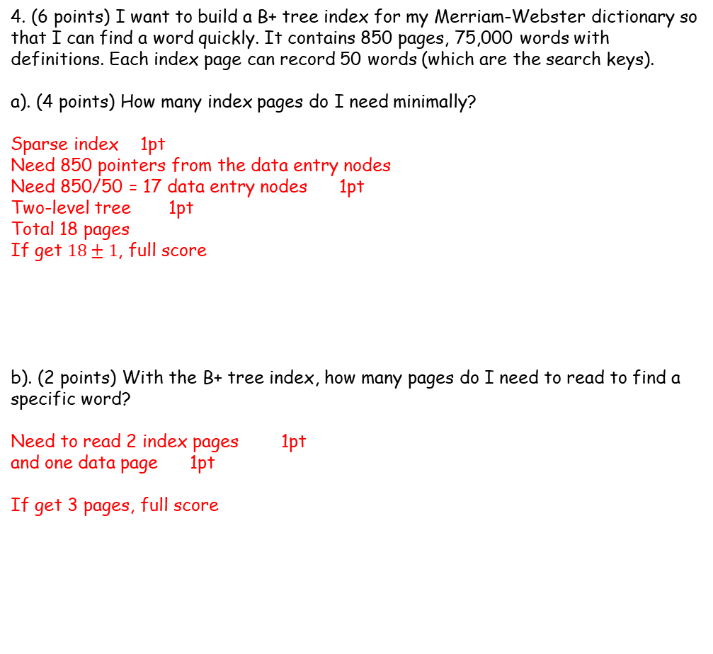
Page 4
4. (6 points) I want to build a B+ tree index for my Merriam-Webster dictionary so that I can find a word quickly. It contains 850 pages, 75,000 words with definitions. Each index page can record 50 words (which are the search keys).
a). (4 points) How many index pages do I need minimally?
Sparse index 1pt
Need 850 pointers from the data entry nodes
Need 850/50 = 17 data entry nodes 1pt
Two-level tree 1pt
Total 18 pages
If get $18±1$, full score
b). (2 points) With the B+ tree index, how many pages do I need to read to find a specific word?
Need to read 2 index pages 1pt
and one data page 1pt
If get 3 pages, full score

Slide 10
5. (9 points) For the following schedule, determine what schedule it is. You must EXPLAIN your answers to get full scores.
S1
a). (2 points) S1 is a strict schedule. Yes[ ] No[ ] Cannot Determine[ ] Reason:
There exists conflict pairs such as T1:R(A), T2:W(A)
b). (3 points) S1 is conflict serializable schedule. Yes[ ] No[ ] Cannot Determine[ ] draw the Precedence Graph and reason:
c). (2 points) S1 is a serializable schedule. Yes[ ] No[ ] Cannot Determine[ ] Reason: it depends on the value of calculation process.
d). (2 points) S1 is a recoverable schedule. Yes[ ] No[ ] Cannot Determine[ ] Reason:
T2 cannot commit until T1 commit
T1 | T2 | T3
R(A)
 | R(A)
 |  | R(B)
 | W(A)
R(B)
 |  | R(A)
W(A)
 | R(A)
 |  | W(B)
 | commit
W(B)
 |  | commit
commit
Choice: 1pt each
Reason: 1pt
For b), the precedence graph is 2pts
The precedence graph does not need to be complete, but it needs to have T1->T2 and T2->T1, or T1->T2->T3. It should not have T3->T2
If missing T3, or have a wrong edge, 1pt
If no cycle, 0pt
If graph is correct, but conclution is wrong, 1pt

Slide 11
6. (10 points) Strict 2PL uses a lock table to track 1) which data object is locked; 2) which transaction owns which lock; 3) which transaction is waiting for a lock on which object. Consider the following schedule. For each step of their execution, write down the status of the corresponding lock table. An execution can result in deadlock. When this happens, you write own “deadlock” and ignore the rest steps.
S1
T1: S(A)
T1 | T2 | T3
S(A)
R(A)
 | S(A)
 | R(A)
 |  | S(B)
 |  | R(B)
 | X(A)
S(B)
R(B)
X(A)
 | W(A)
 | commit
W(A)
 |  | X(B)
commit
 |  | W(B)
 |  | commit
Data | Lock | Owner | Waiting
A | S | T1
B
T1: R(A)
Data | Lock | Owner | Waiting
A | S | T1
B
T2: S(A)
Data | Lock | Owner | Waiting
A | S | T1, T2
B
T2: R(A)
Data | Lock | Owner | Waiting
A | S | T1, T2
B
T3: S(B)
Data | Lock | Owner | Waiting
A | S | T1, T2
B | S | T3
1 pt for each step
After deadlock, if not stop, -3 pts

Slide 12
S1
T3: R(B)
T1 | T2 | T3
S(A)
R(A)
 | S(A)
 | R(A)
 |  | S(B)
 |  | R(B)
 | X(A)
S(B)
R(B)
X(A)
 | W(A)
 | commit
W(A)
 |  | X(B)
commit
 |  | W(B)
 |  | commit
Data | Lock | Owner | Waiting
A | S | T1, T2
B | S | T3
T2: X(A)
Data | Lock | Owner | Waiting
A | S | T1, T2 | T2(X)
B | S | T3
T1: S(B)
Data | Lock | Owner | Waiting
A | S | T1, T2 | T2(X)
B | S | T3, T1
T1: R(B)
Data | Lock | Owner | Waiting
A | S | T1, T2 | T2(X)
B | S | T3, T1
T1: X(A)
Data | Lock | Owner | Waiting
A | S | T1, T2 | T2(X), T1(X)
B | S | T3, T1
Deadlock

Slide 13
7. (15 points) For better current execution, multiple-granularity locking (MGL) introduces three new types of locks, IS, IX, and SIX. Consider the following tree of objects, where each node contains all its children. Note that some nodes have been locked by other transactions and the types of locks are given nearby.
db
IS, IX
IX
f1
f2
IS
IX
p1
p2
S
p3
X
r1
r2
r3
r4
r5
r6
r7
Can have different correct answers
a). (5 points) Suppose Transaction T1 needs to read object r6. What lock(s) on which node(s) does it need to acquire? For each lock, specify if it will be granted.
S(r6) 1pt
IS(P3) 1pt
IS(f2) 1pt
IS(db) 1pt
All granted 1pt
b). (5 points) Suppose Transaction T1 needs to read p2 and write object r4 instead. What lock(s) on which node(s) does it need to acquire? For each lock, specify if it will be granted.
SIX(p2) 1pt
X(r4) 1pt
IX(f1) 1pt
IX(db) 1pt
All granted 1pt
c). (5 points) Suppose Transaction T1 needs to write r1 and r3 instead. What lock(s) on which node(s) does it need to acquire? For each lock, specify if it will be granted.
X(r1) 1pt
X(r3) 1pt. Not granted 1pt
IX(p1) 1pt
IX(f1) 0.5pt
IX(db) 0.5pt

Slide 14
8. (7 points) MOLAP.
Suppose the size of different dimensions are
A: 100, B: 500, C: 2000
Chunk size is 50* 100 * 200 (for A, B, and C dimensions, respectively)
a). (2 points) What is the best order of loading chunks?
Dim A<B<C
So
For C
for B
for A
b). (5 points) What is the minimal memory requirement?
One chunk of BC + one row/column of AC + all chunks in AB
=chunk B * chunk C + chunk C*entire A + entire A * entire B
=100*200 + 200*100 +100*500
=20,000 + 20,000 + 50,000
=90,000
If get 90,000, full score
First 2 steps: 2pts
If plug in correct values, 2pts

